Slide 1

Kari Bernhardt RN BSN CEN DNP-S & Kathryn Traynor RN BSN DNP-S School of Health Sciences, University of Mary NUR 589: Common & Chronic Healthcare Management Dr. Jenna Herman August 11th, 2021
Social Disparities in
Surgical Care

Slide 2
Objectives
Defining surgical care
Overview of rural health
General surgeon rates in rural locations
Surgical care in North Dakota
The clinical problem
Case study

Slide 3
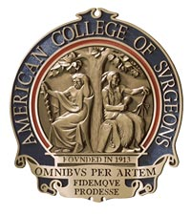
SURGICAL CARE
Phases of surgical care
Surgical settings
Surgical specialties
The FNP's role in surgical care
(American College of Surgeons, 2021a)
(American College of Surgeons, 2021b)
Notes:
Phases of surgical care
- preoperative
- perioperative
- intraoperative
- postoperative
- post discharge
Surgical settings
- inpatient
- outpatient, ambulatory
Surgical specialties
- there are 14 surgery specialties. Most of the specialties will then have areas of expertise within that specialty.
The FNP in primary care settings is responsible for assessing and diagnosing possible surgical cases and referring them to a specialist. The FNP working with a surgeon may be responsible for seeing patients in clinic or the hospital pre op or post op, and may assist with surgery.

Slide 4
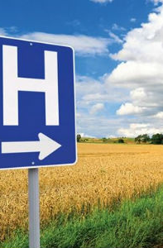
RURAL HEALTH
What is considered rural?
60 million Americans live in rural areas
Greater risk for death from 5 leading causes
Pediatric rural health disparities
Why is there this increased health risk for rural Americans?
North Dakota
(CDC, 2017)
(Sticca & Aaland, 2015)
(United States Census Bureau, 2010)
Notes:
When we think of rural a picture of rolling hills and farmlands will likely come to mind. It is difficult to define the term rural. The Census Bureau defines rural as any population, housing, or territory NOT in an urban area. Urbanized areas are defined as an area that has a population of 50,000 or more. Compared to metropolitan locations, rural communities are often understaffed with health care providers of all specialities. Most rural patients would prefer to receive their medical care in their own communities whenever the services are available.
There are 46 million Americas who live in rural areas of the country. That is 19% of the US population. These Americans face numerous health disparities in comparison to their urban living counterparts.
Rural Americans are more likely to die from heart disease, cancer, unintentional injury, chronic lower respiratory disease, and stroke than their urban counterparts. Unintentional injury deaths are approximately 50 percent higher in rural areas than in urban areas, partly due to greater risk of death from motor vehicle crashes and opioid overdoses.
Children in rural areas also face challenges. A recent CDC study finds that children in rural areas with mental, behavioral, and developmental disorders face more community and family challenges than children in urban areas with the same disorders.
Rural areas have certain characteristics that increase resident’s risk of death; a large piece is long travel distances to specialty and emergency care. The CDC reports that rural Americans have higher rates of cigarette smoking, high blood pressure, obesity, and poverty; and report less leisure-time physical activity and lower seatbelt use than their urban counterparts, less access to healthcare, and less likely to have health insurance. All of these factors lead to poor health outcomes.
CDC (2017).
North Dakota has only 3 cities of metropolitan with a population over 50,000. The majority of the state's population lives in small or isolated rural areas. Therefore, the majority of North Dakota residents suffer from health disparities due to rural health.

Slide 5
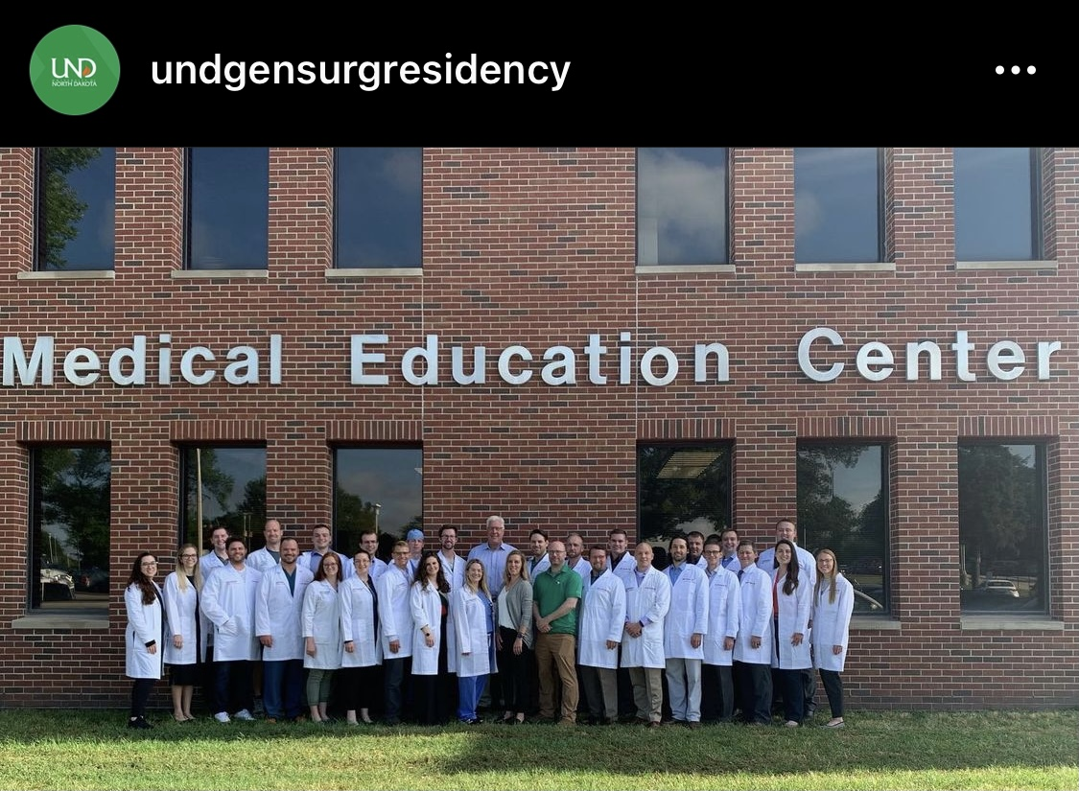
General Surgeons in Rural ND
The demand for rural general surgeons
Barriers to rural surgery recruitment and retention rates
UND Medical School & Surgical Residency Program
(Sticca & Aaland, 2015)
Notes:
Many patients in small or isolated rural areas must commute distances of over 1 hour to see a surgeon. This commute may be much longer, or even impossible at times, because of inclement weather, as the majority of our year is winter. Patients not only need to drive for their operation, but also pre-op and post-op appointments. And if it is a procedure that requires a stay in the hospital your family or friend who is driving you needs to stay there or they have to drive back and forth to do drop off and pick ups. When Kari and I were discussing this topic we thought of our elderly grandparents who can't drive anymore and relay on coordinating appointments with our parents/their children for rides to and from appointments and procedures.
Unfortunately, for many rural communities, surgical care is very limited or nonexistent. The demand for general surgeons in rural locations is projected to be among the highest of any medical specialty in the next decade.
Rural communities often have a difficult time recruiting and retaining general surgeons due to several factors including:
Professional/social isolation
Lack of practice coverage for vacations, attendance at continuing medical education programs, new skill training
Lower reimbursement/increased expenses
Limited resources and capabilities of rural hospitals
Call coverage and lifestyle concerns
Administrative requirements for practice maintenance
Increasing regionalization of medical care
Difficulty in recruitment and retention
Decreased interest in broad-spectrum general surgery practice
Increasing subspecialization in general surgery
Lack of broad-based training for rural surgery practice
I was talking about this issue with my mom a couple weeks ago and we also discussed that it would be hard being the only surgeon in an area as a new, fresh out of residency surgeon. You wouldn't have colleagues in the OR right next to you to discuss an issue with or to come and assist you with an operation. Although you wouldn't be performing the high stress and skilled operations, complications and question will arise especially as a newer surgeon.
North Dakota has one medical school, the University of North Dakota in Grand Forks. North Dakota is the only state in a four-state area that has a surgical residency program in Fargo. Montana, Wyoming, and South Dakota do not have surgical residency programs and must obtain their surgeons from residency programs in other parts of the country. These states surrounding North Dakota to the south and west have demographics similar to North Dakota. They have large population centers in each of these states where surgery supply is adequate, smaller communities have few or no surgeons.

Slide 6
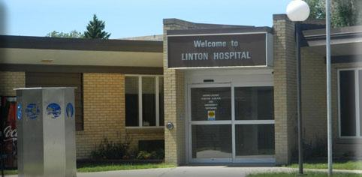
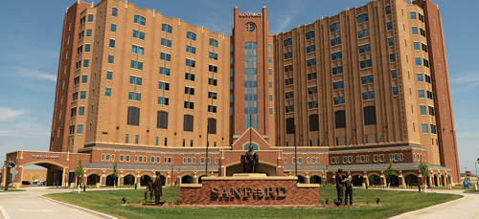
Healthcare Services in ND
47 Licensed and certified general acute care hospitals
California has 8,222 healthcare services and 570 hospitals (104,034 beds)
36 Critical Access Hospitals
2 Indian Health Services
3 Psychiatric Facilities
(University of North Dakota School of Medicine & Health Science, 2021)
Notes:
(University of North Dakota School of Medicine & Health Science, 2021)

Slide 7
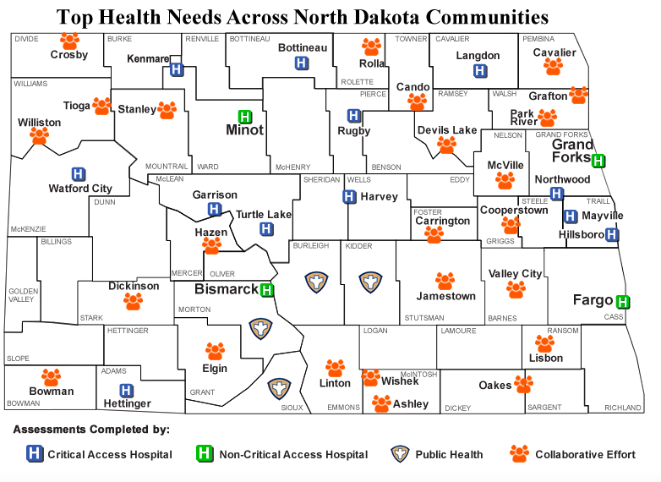
(Centers for Rural Health, 2021)
Notes:
Here is a map of all healthcare facilities in ND including critical access, non-crical access, public health, and those working collaboratively --- from this ap I would like to note there are SEVERAL counties without ANY serves like golden valley, and billings to name a few
Public health options --- middle/southern ND Only

Slide 8
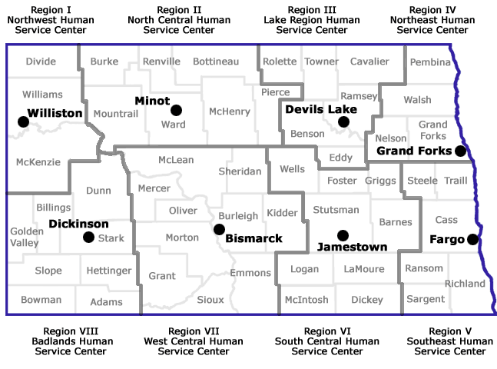
(North Dakota State Government, 2016)
Notes:
I like this map because it visually displays the different healthcare regions in ND with the area servicing the largest amount of services within the region…
The North Dakota Department of Human Services operates eight regional human service centers. Each serves a designated multi-county area, providing counseling and mental health services, substance abuse treatment, disability services and other human services.

Slide 9
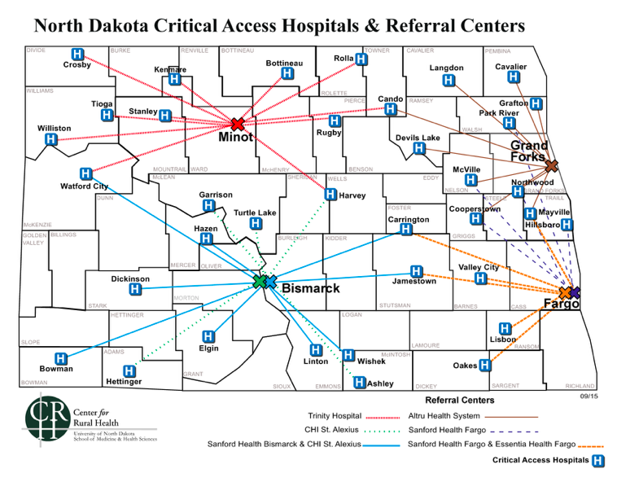
(Centers for Rural Health, 2015)
Notes:
And finally, I included this map because it demonstrates hospital referral systems and just how far individuals have to travel to receive select services … for example someone from Bowman requiring surgical services would have to travel to Bismarck which is 175 miles or just over 2 and a half hours
The Ambulatory Surgical Centers in North Dakota are certified by CMS to participate in the Medicare/Medicaid program. Ambulatory Surgical Center or ASC means any distinct entity that operates exclusively for the purpose of providing surgical services to patients not requiring hospitalization and in which the expected duration of services would not exceed 24 hours following an admission (North Dakota Department of Health, 2020).
ND ambulatory surgical options: 13
Burleigh – 3
Stark- 1 (Dickinson)
Cass- 6 (fargo)
GF- 1
Richland- 1
Williams 1

Slide 10
Surgical Services in Different Part of ND
Linton
Surgical services
biopsies & outpatient
Providers
2 MDs
2 PA-C
2 FNP-C
Visiting Specialty Services
Referral: Bismarck; 66 miles
Devils Lake
Surgical
Ophthalmology
Obstetrics
Endoscopy
Outpatient Dialysis
Providers
9 MDs
2 Nurse Anesthetists
3 PA-C
4 NPs
Referral: Grand Forks; 90 miles
(CHI St. Alexius Health, 2021)
(Linton Hospital, n.d.)
Notes:
Hard to know what surgical services are offered at different facilities throughout ND without specifically calling each hospital because services are always changing depending on provider availability.
Linton: *** so if you break your arm on the 2nd Wednesday of the month… you have to wait an entire month to see an orthopedist
General and critical care surgeon visits once a month
Podiatry Services last Thursday of every month
Urology 4th Monday of every month
Orthopedics 2nd Tuesday of every month
OBGYN – 3rd Wednesday of every month
General Surgery – 1st Thursday
Sleep Diagnostics – monthly
Cariology – 2nd Tuesday

Slide 11
The Clinical Problem
Rural North Dakota residents do not have adequate access to surgical care. This is affected by low surgeon rates in rural areas, driving distances to appointments and procedures, limited access to preventative and emergency health care. This health disparity affects both sexes, all ethnicities, and every age group of individuals living in rural areas.

Slide 12
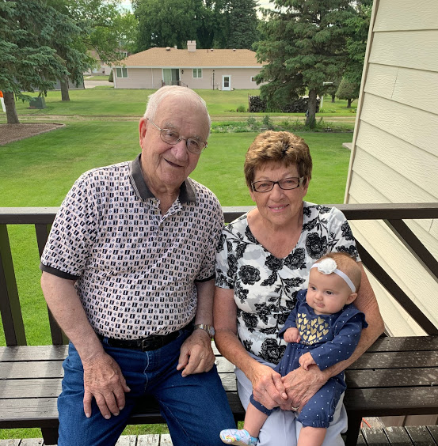
Case Study
Sally is a 75-year-old, retired housewife without a driver’s license. She relies on her husband to get from place to place; unfortunately, he has poor eye site and has difficulty driving in the dark. She lives with her husband on a farm in rural ND. Currently, the closest critical access hospital is 25 minutes away.

Slide 13
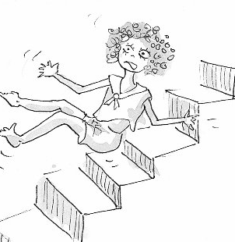
While cleaning the house one August evening, Sally fell down the stairs on an outstretched arm carrying a bucket of cleaning supplies. Her husband Tony is helping their son harvest wheat . There is poor cell service, so Sally cannot get ahold of Tony. She decides to wait until Tony gets home because she cannot driver herself to the hospital and her arm doesn’t hurt “that bad.”

Slide 14
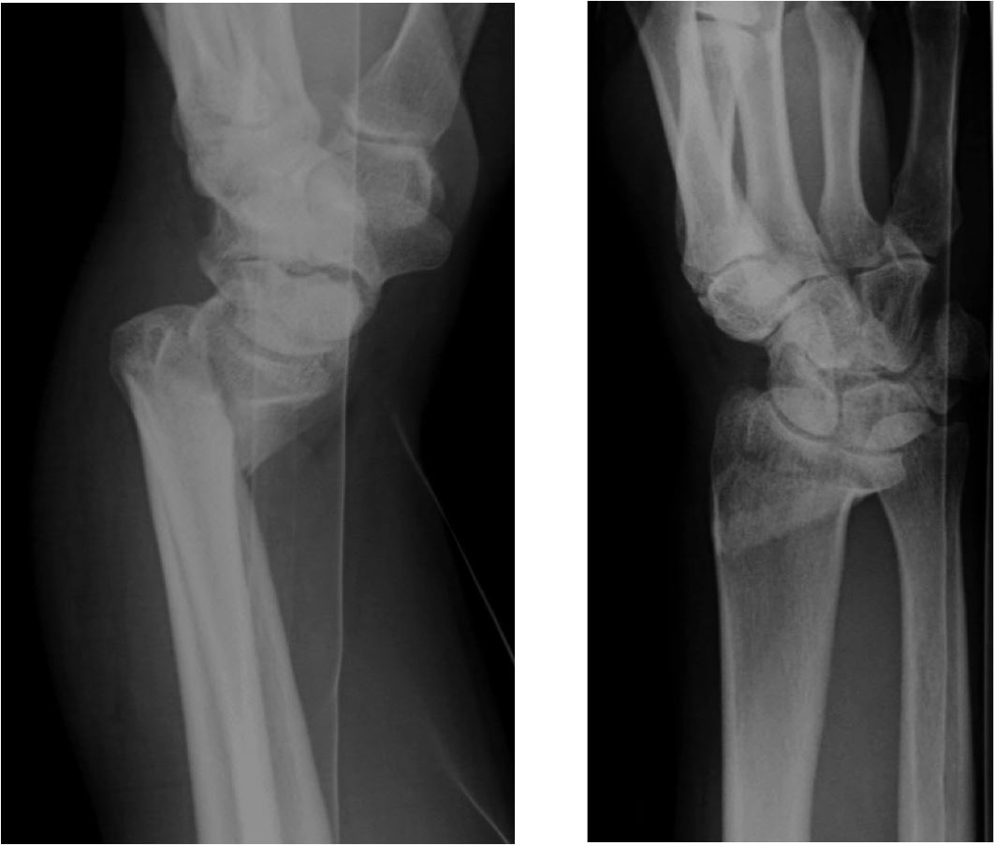
When Tony returns, it is late in the evening and dark outside. They decide to wait until the following morning to take Sally to the hospital when it is light outside.
The next day, they drive to the nearest critical access hospital. The provider on staff is a nurse practitioner. She assesses Sally and receives a confirmatory x-ray of a displaced wrist fracture.

Slide 15
Immediate Interventions
Local EMS services
Visiting physician consult
Orthopedics 2nd Tuesday of every month
Wrist Splint
Pre-op preparations per ortho MD
X-rays
Blood work
EKG
Refer & transfer
Notes:
Because her wrist is displaced, the NP should splint the wrist as is to prevent further injury.
A relationship has been established with orthopedics who visits every month--- the NP calls this orthopedist for a consult. He recommend transfer to the nearsest hospital for a surgical consult

Slide 16
Intermediate Interventions
Alignment of post-op visit when orthopedist visits local facility
Transit services
Use of telemedicine for post-operative visits
Physical therapy
Notes:
South Central Transit - transportation is available to take the general public to and from meal sites and for other purposes which include: medical appointments, shopping, recreation, schools and personal needs. Wheelchair accessible vehicles are available.

Slide 17
Long-Term Management
The University of North Dakota School of Medicine and Health Science's Rural Surgery Support Program
Specialty FNP or MD travel to locations 1-2x/month
Incentives to attract providers
Mobile Clinics
Notes:
https://bulletin.facs.org/2015/07/the-north-dakota-rural-surgery-support-program-providing-surgical-services-to-communities-in-need/
Incentives to attract providers– tuition reimbursement, bonuses, free housing, child care…
The Operation of Mobile Clinics is to render Primary Health Care services to those in remote / specified areas who have access to little or no medical facilities. --- this might help with pre-op, post-op visits

Slide 18

Questions?

Slide 19
References
American College of Surgeons. (2021a). New approach to surgical management: Phases of surgical care. Bulletin. Retrieved from https://www.facs.org/advocacy/quality/phases
American College of Surgeons. (2021b). What are the surgical specialties? Bulletin. Retrieved from https://www.facs.org/education/resources/medical-students/faq/specialties
Centers for Disease Control and Prevention. (2017). Rural health: About rural health. U.S. Department of Health and Human Services. Retrieved from https://www.cdc.gov/ruralhealth/about.html
Centers for Rural Health. (2015, September). North dakota critical access hosptials & referral centers [PDF]. University of North Dakota School of Medicine & Health Sciences. https://www.health.nd.gov/media/1457/ndcah_map.pdf
Centers for Rural Health. (2021). Top Health Needs by Community. Center for Rural Health. https://ruralhealth.und.edu/projects/community-health-needs-assessment/community-needs
CHI St. Alexius Health. (2021). Chi st. alexius health devils lake hospital. https://www.chistalexiushealth.org/locations/devils-lake

Slide 20
References
Linton Hospital. (n.d.). General and Acute Services. Linton Hospital. https://www.lintonhospital.org
North Dakota Department of Health. (2020). Ambulatory surgical centers. Department of Health. https://www.health.nd.gov/regulation-licensure/health-facilities/ambulatory-surgical-centers
North Dakota State Government. (2016). Regional human service centers. Department of human services: State of north dakota. https://www.nd.gov/dhs/locations/regionalhsc/
Sticca, R. & Aaland, M. O. (2015). The North Dakota rural surgeon support program: Providing surgical services to communities in need. Bulletin of the American College of Surgeons. Retrieved from https://bulletin.facs.org/2015/07/the-north-dakota-rural-surgery-support-program-providing-surgical-services-to-communities-in-need/
United States Census Bureau. (2010). Rural America. Retrieved from https://mtgis-portal.geo.census.gov/arcgis/apps/MapSeries/index.html?appid=49cd4bc9c8eb444ab51218c1d5001ef6
University of North Dakota School of Medicine & Health Science. (2021). North dakota hospitals. Centers for Rural Health. https://ruralhealth.und.edu/projects/flex/hospitals

